Slide 1
Tutorial PIC16F18877
Introducción básica a la programación de MPLAB X IDE con Code Configurator.

Slide 2
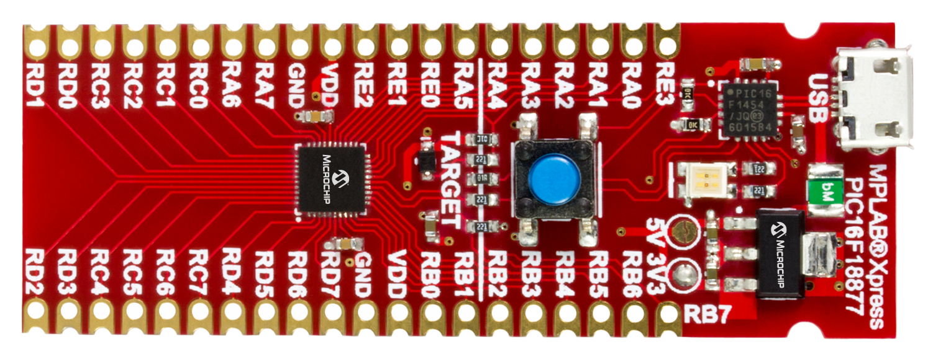
Principales características de la tarjeta MPLAB Xpress
Reset button
Programmer
Target PIC16F18877
3.3 volts or 5 volts

Slide 3
PIC16F18877 Características
56 Kb Program Memory
8 Mhz CPU Speed (32 Mhz)
4 kb SRAM
1-USART,2-SPI,2-I2C
5-CCP
Timers 3 x 8-bit ,4 x 16-bit
ADC2 10-bit resolution
CWG (Complementary Waveform Generator)
DSM (Data Signal Modulator)
ZCD (Zero Cross Detect)
CRC ( Cyclical Redundancy Check)
And more.

Slide 4
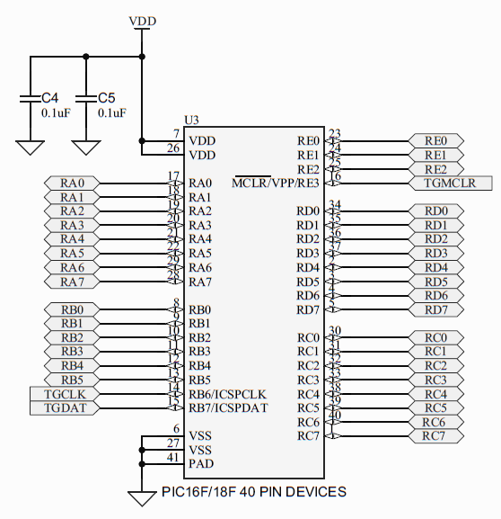
Diagrama

Slide 5
Software
MPLAB X IDE
Code Configurator
XC8

